Slide 1
New CDM+ Plans and Prices
March 2021
Suran Systems, Inc.

Slide 2
Agenda
A look at CDM+ today
Explain plans for new and current clients
Walk through transition for current clients
Q & A

Slide 3
Online Resources
cdmplus.com
Brand new site
Launched Monday 3/15
help.suran.com
New CDM+ Sales Area
Full details on what we’ll cover today

Slide 4
CDM+ Today

Slide 5
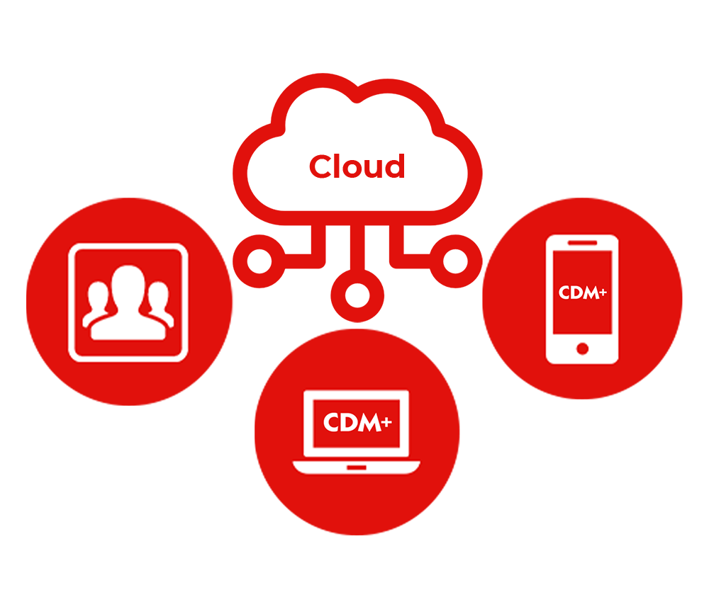
CDM+ Software Suite
https://www.cdmplus.com/desktop-web-and-mobile-platforms/

Slide 6
Right Tool for the Job
CDM+ is Cloud Computing
CDM+ Desktop offers powerful, robust database software (e.g. accounting operations and reporting)
CDM+ Mobile provides fast, purpose-built data access (e.g. attendance entry, check-in, and receipts)
Engage provides a familiar, online experience for members and visitors (e.g. online giving and directories)
Hosted data in our managed cloud connects and integrates everything

Slide 7
The Key is Integration

Slide 8
Integration Equals Value
Save time importing
Save money paying for discrete systems
Save time updating separate systems
Accurate, centralized data avoid mistakes that cost time, money, and confusion

Slide 9
CDM+ Supporting Services
Routine software updates and upgrades
Constantly updated documentation (help.suran.com)
First class support
Excellent training options

Slide 10
This is CDM+ today
And we want ALL of CDM+ to power your good work in the world

Slide 11
New Clients

Slide 12
CDM+ Pricing: New Clients
Core | Choice | Complete | Grow
$100/month | $50 month + $25/additional program | $175/month | $50/month
Membership, Contributions, Accounting & Payroll | Mix and match | All | Membership, Contributions, Accounting & Payroll
Unlimited Givers | Unlimited Givers | Unlimited Givers | 50 Givers*
Unlimited Individuals | Unlimited Individuals | Unlimited Individuals | 75 Individuals*
* Can increase to 75 givers, 100 individuals for $75/month

Slide 13
Standard Features
Included in all plans
Data Hosting
Engage (including merchant account)
Online Giving, Payroll Direct Deposit
Mobile
Email and Phone support
Updates
Complimentary new user/staff training

Slide 14
cdmplus.com/pricing

Slide 15
Current Clients

Slide 16
Changes Affecting Everyone
Payroll is bundled with Accounting—no more $5/month charge
Active enrollment in a plan is required to calculate payroll and generate tax forms (same as before). Any plan meets this requirement
Engage Standard/Payroll/Complete (announced September 2020) have been merged into a single Engage product
User licenses are $5/month for all plans
Additional organizations are $15/month for all plans (max $30/parent organization)

Slide 17
Additional Organizations
Replaces Shared Hosting and Engage Complete (Additional Account)
Used for discrete organizations—separate FEIN/501(c)(3) that share administrative staff. Examples:
A cluster of churches that share administrative staff
A church with attached childcare that has its own FEIN
An organization whose staff administer a separate foundation or ministry with their own FEIN

Slide 18
Navigating New Pricing
Factor to consider:
SAAS vs. Traditional
Previous Plans
Previous Renewal Terms
What do you need?
See the email we sent last week for specific details
Contact sales@cdmplus.com

Slide 19
SAAS vs. Traditional
SAAS
Software as a Service (SAAS) is how we’ve sold CDM+ since 2015
No up-front cost; software cost is bundled into ongoing fee
SAAS examples:
Adobe Creative Suite
Microsoft Office 365
G Suite
Most software licenses used today

Slide 20
SAAS vs. Traditional
Traditional
Begin with a costly one-time software purchase (~ $1,000)
Optional services extend that purchase
Support w/ Updates
Hosting
Engage
Think boxed software on a CD

Slide 21
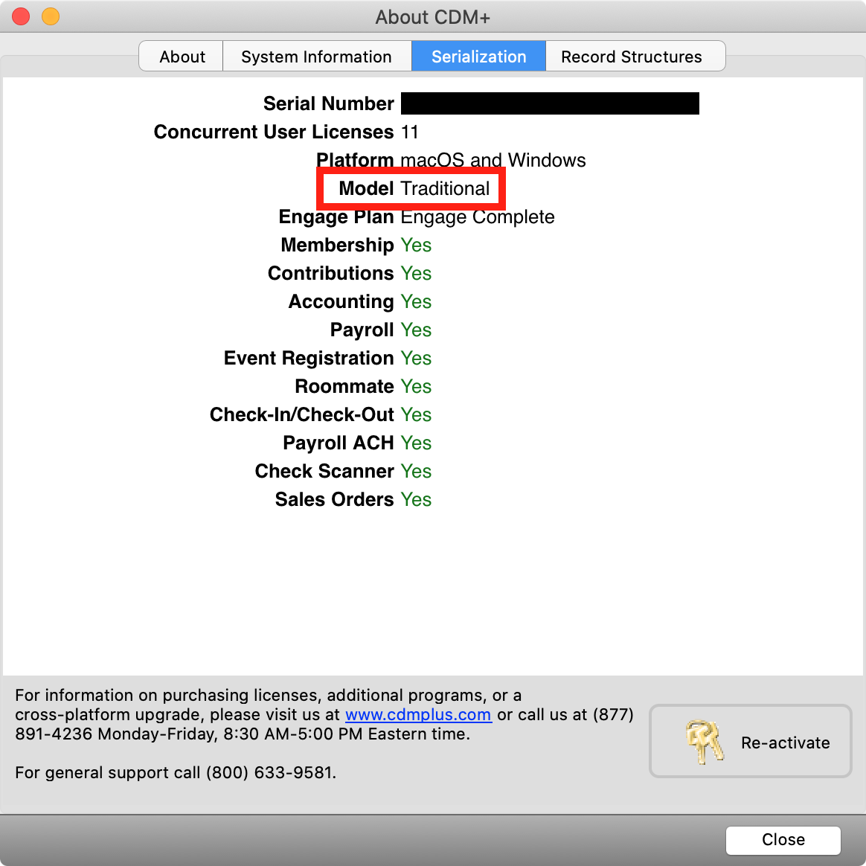
SAAS vs. Traditional
How do I tell?
CDM+ (macOS) or File (Windows)
About CDM+
Serialization
https://help.suran.com/sales/latest/traditional-licenses/saas-vs-traditional

Slide 22
New Plans and Pricing for
Current SAAS Clients

Slide 23
New Pricing for SAAS Clients
Moving to current pricing on cdmplus.com
Everyone either gains features or saves money
Additional users are now $5/month instead of $10/month

Slide 24
SAAS Example
Core
Membership, Contributions, Accounting & Payroll
2020 Price w/o Engage: $80/month
2020 Price w/ Engage: $125/month
2021 Price (includes Engage): $100/month
Benefits:
Full Engage OR Savings

Slide 25
SAAS Example
Single Program
Accounting & Payroll
2020 Price w/o Engage: $40/month
2020 Price w/ Engage Payroll: $70/month
2021 Price (includes Engage): $50/month
Gains:
Full Engage (incl. Engage Billing)

Slide 26
SAAS Example
Complete
Membership, Contributions, Accounting & Payroll, Event Registration, Roommate, Check-In/Check-Out, Engage Complete, 7 users
2020 Price: $240/month
2021 Price: $175/month
Gains:
Unlimited users
Sales Orders & Regional
Savings

Slide 27
Timing
SAAS rates are locked in for 2 years
Anyone who purchased March 2019 or earlier will see new rates beginning April 2021
Otherwise your rate will increase 25 months after purchase
See the plan announcement email or contact sales@cdmplus.com
Even if your price change is delayed, you still get new features TODAY!

Slide 28
SAAS Benefits: Engage
If you haven’t setup Engage you can do so now at no additional cost!
If you already have some Engage, you now have all of it
If you already had all Engage, enjoy the cost savings!

Slide 29
SAAS Benefits: Engage
Integrated online giving
Online directories
Payroll Direct Deposit
And more
Contact sales@cdmplus.com to get started

Slide 30
New Plans and Pricing for
Current Traditional Clients

Slide 31
Previous Options
Can be mixed/matched
Premier Support
Data Hosting
Engage (Standard/Payroll/Complete)
Payroll Support
Shared Hosting
Additional program: $400
Additional users: Varies

Slide 32
New Plans
Inclusive, single price
Cloud (same as Choice/Core, just cheaper)
Budget
Basic
Additional program: $200
Additional users: $5/month
Everyone either gains features or saves money

Slide 33
New Plans
 | Basic | Budget | Cloud
Base (1 program; 1 license) | $10 | $30 | $45
Per additional program | $5 | $10 | $15
Upgrades | ✅ | ✅ | ✅
Hosting | ✅ | ✅ | ✅
Help Center Support | ✅ | ✅ | ✅
Email and Phone Support | $125/instance | ✅ | ✅
Mobile and Engage | ❌ | ❌ | ✅

Slide 34
Examples
Core: Membership, Contributions, Accounting & Payroll, 1 license
Support | $39.17
Support + Hosting | $64.12
Support + Hosting + Engage | $109.12
Payroll Support Only + Annual Upgrade | $13.54
Hosting Only | $24.95
Basic | $20.00
Budget | $50.00
Cloud | $75.00

Slide 35
Examples
Core: Membership, Contributions, Accounting & Payroll, 1 license
Previous Configuration | Previous Monthly Rate | New Plan | New Monthly Rate
Support | $39.17 | Budget | $50.00
Support + Hosting | $64.12 | Cloud | $75.00
Support + Hosting + Engage | $109.12 | Cloud | $75.00
Payroll Support Only + Annual Upgrade | $13.54 | Basic | $20.00
Hosting Only w/o mobile | $24.95 | Budget | $50.00

Slide 36
Selecting a Plan
Suran’s pre-selection
In general…
Payroll Support Only went to Basic
Support Only went to Budget
Support and Hosting went to Cloud
Anyone using Mobile or Engage went to Cloud
Anyone exceeding $175/month went to Complete
See help.suran.com for a handy explanation
See your email for your specific situation

Slide 37
Selecting a Plan
Your options
Can adjust your plan at any time with no financial impact until your next renewal
For example, Suran chose Budget and you renew in August. You can move to Cloud today and not pay any increase until August.
For everyone except budget, there is a more affordable option
Can move from one plan to a higher plan on a short-term basis (minimum 3 months)
For example, to get support on a new program under Budget, then move to Basic
Contact sales@cdmplus.com and we’ll work to find the best option for you

Slide 38
Per-Instance Support
Increasing from $55 to $125 (first increase to this fee in many years)
Help Center and YouTube channel are always free and constantly improving
An instance is one issue, not individual calls or emails
Connecting to hosting or issues arising from a bug are not billable
Connecting to self hosting or assistance moving off hosting is billable

Slide 39
New Plan Benefits
See your email for details on when pricing changes go into effect
You get access to new benefits TODAY
For EVERYONE, you can go on hosting at no additional charge
For EVERYONE, you can upgrade to the latest version at no additional charge
For those on Cloud, you can enroll in Engage for no additional charge

Slide 40
Benefits: Upgrade
CDM+ 11.1.4 is available today
Or try the 11.1.5 beta (expected to become the final version next week)
download.cdmplus.com
Check System Requirements
CDM+ 11.1
CDM+ 12.0 for this Fall

Slide 41
Benefits: Hosting
Offsite backups
Remote access from any internet-connected computer
Managed uptime
Hosting becomes a solution without a cost factor
70% of our clients are already hosted
Contact sales@cdmplus.com to arrange boarding
No learning curve—use CDM+ as you always have

Slide 42
Benefits: Engage
Integrated Online Giving
Online Directories
Payroll Direct Deposit
Employee pay stub access
Online Registrations
And more

Slide 43
Engage: Online Giving Value
No monthly fees
$0.30 + 0.8% ACH
$0.30 + 2.9% MasterCard/Visa/Discover
$0.30 + 3.5% American Express
Fee Assist ensures you get 100% of the gift
Direct entry into CDM+ Contributions
Direct posting into your ledger
Save time and improve accuracy

Slide 44
Engage: Payroll Direct Deposit Value
No monthly fees
$1.00 per batch plus $0.30 per employee account
Automatic split to employee accounts (ex. savings, HSA)
Can mix and match paper checks and direct deposit
Direct posting to your ledger
Matches bank statement to the penny
No re-keying into your bank’s website

Slide 45
Renewal Date

Slide 46
Possible Current Renewals
Could be annual
Could be monthly
Could be 2-way mixed annual (support in January, hosting in June)
Could be 3-way mixed annual (support in April, hosting in July, Engage in December)
Could be annual/monthly (support in May, monthly hosting)
Could be mixed monthly/annual (annual support in March, Hosting in June, monthly Engage)

Slide 47
Going Forward
Moving to one renewal date and aligning mixed annual renewals
Can split the new renewal to stay in budget for your fiscal year
If you had a monthly component you will move to monthly after annual runs out
Can switch to annual if you prefer—annual pricing is monthly times 12
Those saving money will see a cost savings ASAP
Increases will occur after the current renewal expires
You get access to new benefits TODAY
Monthly renewals requires automatic payment through ACH or Credit/Debit card

Slide 48
Mixed Annual
179 days
$2.34/day
$1.40/day
Support ($510.00)
?
Hosting ($341.43)
107 days
July 2021
Nov 2021
Jan 2022
179 days x $1.40/day = $250.60
$250.60 ÷ $2.34/day = 107 days

Slide 49
It’s getting simpler 🙂

Slide 50
Next Steps
Review your plan
Talk to sales if you want to make adjustments
sales@cdmplus.com
877-891-4236
Go on hosting (schedule with sales)
Upgrade (download.cdmplus.com)
Enroll in Engage (contact sales)

Slide 51
A note about our Q & A
We are happy to answers your questions…
But we won’t review your specific configuration during the public webinar
This is for confidentiality and privacy
Instead, contact sales to cover your specific configuration
Feel free to ask about elements that apply to your specific configuration, but we won’t pull up your pricing and talk through it point by point while everyone listens

Slide 52
Q & A

